Slide 1
CTF
Coding Challenge

Slide 2

Hello!
I am Pawel Kubacki
I am here because I love to give presentations :)
You can find me at pkub@oticonmedical.com

Slide 3
The process
Implement
Share
Chose
Design

Slide 4
1.
Which type to chose?
Let’s start with the CTF or CC first

Slide 5
CTF - ( Capture the flag)
For everyone
For sure one+ player :)
Long
Unfair

Slide 6
CC – (Coding challenge)
Short
Visually interesting
Programmers
Hard

Slide 7
My point of view
Flexibility
Experience
Fun & entertaiment
CTF
CC

Slide 8
CODING CHALLENGEEEEE !!!!!!

Slide 9
2.
DESIGN
Let’s start with „basic” :)

Slide 10
Basic questions
How long?
How many players?
Who can join?
Programing?
Teams?
Visualization?
- 1H
- Up to 16
- Everyone
– YES!
– YES! (up to 3)
– YES!

Slide 11
Detailed questions
How to reduce scope?
Expectations?
Who can watch?
Theme?
Language?
- Unity3d engine
- Single file
- Everyone
– You will know!
– C#, JS

Slide 12
3.
Implement
But what?

Slide 13
What?!
THE GAME
Figure out how to make a game if you are told that it is not allowed but you really want :0

Slide 14
The game
Jump in
Should be easy to understand the overall goal and then to jump in into designing.
Easy but complex
It should be possible to figure out fast algorithm but complex enought to force thinking.
Entertaiment
We want to see how our code deals with the problem!
Jump in
Should be easy to setup enviroiment so the time is not wasted on fixing bugs.
Easy
The expected inputs and outputs should be easy to undertand and to process.
Entertaiment
We want to see how our code compete with others code.

Slide 15
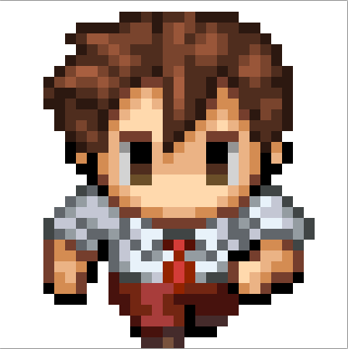
A picture is worth a thousand words
This is how your code will look like.

Slide 16







More?!
Tapani?

Slide 17
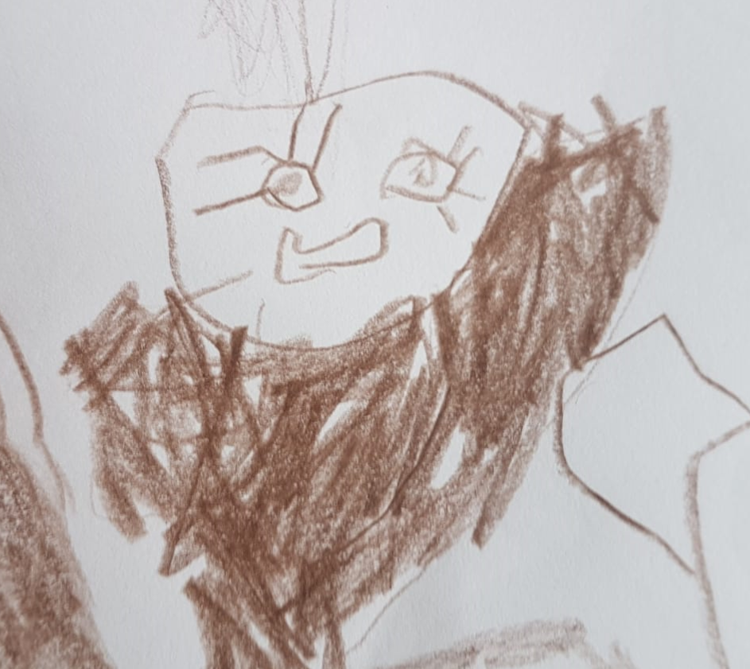
ART!

Slide 18
Difficulty
Hard
Asian
Easy
Normal
Super easy

Slide 19
Current status
 | Design | Foundation | Final touches
Game concept
Game implementation
Game guide

Slide 20
4.
Share
So I haven’t so far?
:0

Slide 21
Small teaser

Slide 22
What else to share?

Slide 23
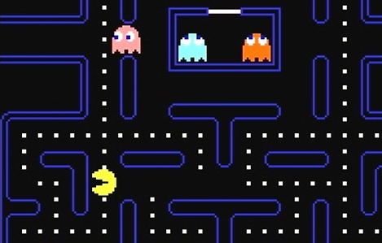
Next?
Just polish and play!
Place your screenshot here

Slide 24
THANKS!

Slide 25
Questions?
My office

Slide 26
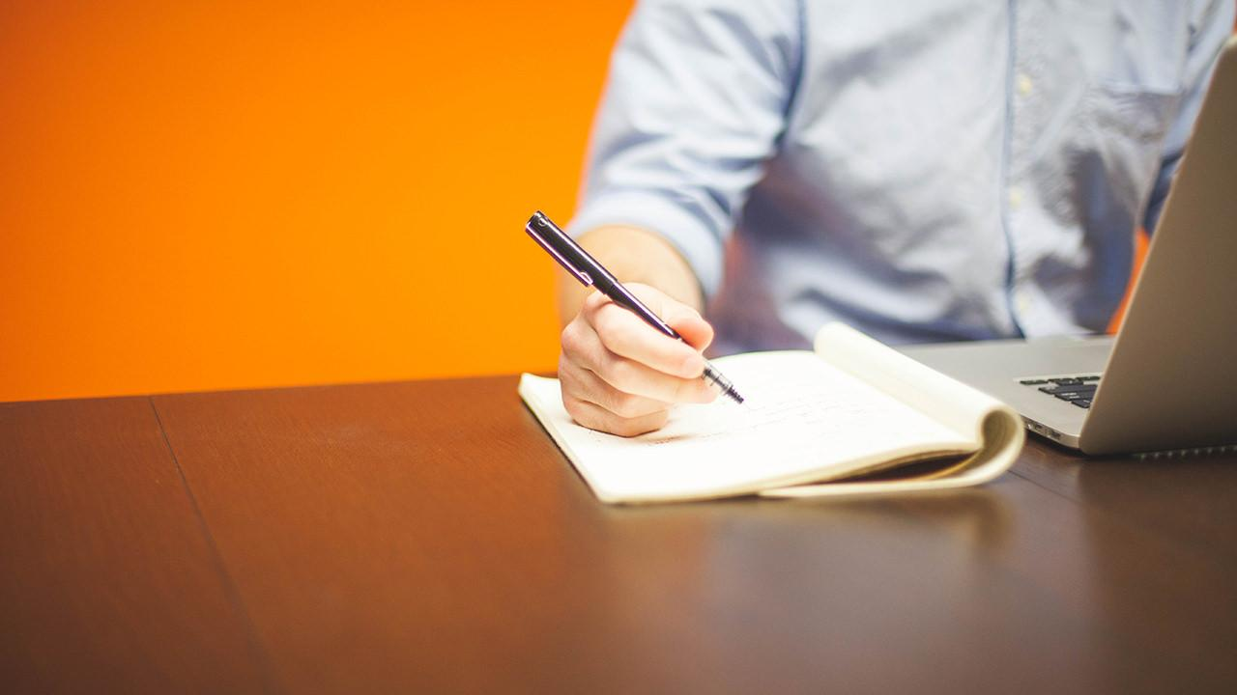
Want big impact?
Use big image.

Slide 27
89,526,124
Whoa! That’s a big number, aren’t you proud?

Slide 28
89,526,124$
185,244 users
100%
That’s a lot of money
And a lot of users
Total success!

Slide 29
Let’s review some concepts
Yellow
Is the color of gold, butter and ripe lemons. In the spectrum of visible light, yellow is found between green and orange.
Blue
Is the colour of the clear sky and the deep sea. It is located between violet and green on the optical spectrum.
Red
Is the color of blood, and because of this it has historically been associated with sacrifice, danger and courage.
Yellow
Is the color of gold, butter and ripe lemons. In the spectrum of visible light, yellow is found between green and orange.
Blue
Is the colour of the clear sky and the deep sea. It is located between violet and green on the optical spectrum.
Red
Is the color of blood, and because of this it has historically been associated with sacrifice, danger and courage.

Slide 30
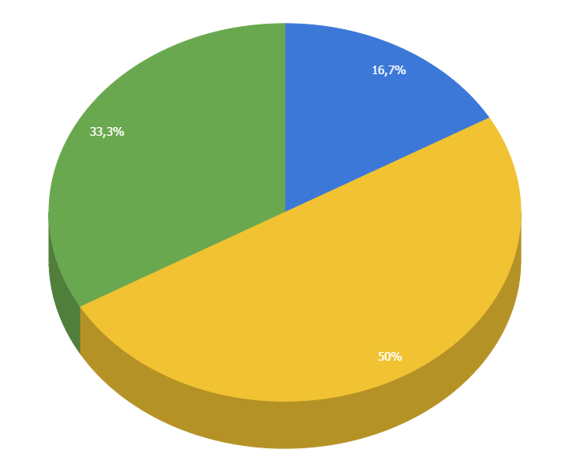
You can copy&paste graphs from Google Sheets

Slide 31
Android project
Show and explain your web, app or software projects using these gadget templates.
Place your screenshot here

Slide 32
iphone project
Show and explain your web, app or software projects using these gadget templates.
Place your screenshot here

Slide 33
tablet project
Show and explain your web, app or software projects using these gadget templates.
Place your screenshot here

Slide 34
Credits
Special thanks to all the people who made and released these awesome resources for free:
Presentation template by SlidesCarnival
Photographs by Startupstockphotos

Slide 35
Presentation design
This presentation uses the following typographies:
Titles: Bangers
Body copy: Sniglet Regular
You can download the fonts on these pages:
https://www.1001freefonts.com/bangers.font
https://www.fontsquirrel.com/fonts/sniglet
You don’t need to keep this slide in your presentation. It’s only here to serve you as a design guide if you need to create new slides or download the fonts to edit the presentation in PowerPoint®

Slide 36
SlidesCarnival icons are editable shapes.
This means that you can:
Resize them without losing quality.
Change fill color and opacity.
Change line color, width and style.
Isn’t that nice? :)
Examples:

Slide 37
Diagrams and infographics

Slide 38
😉
Now you can use any emoji as an icon!
And of course it resizes without losing quality and you can change the color.
How? Follow Google instructions https://twitter.com/googledocs/status/730087240156643328
✋👆👉👍👤👦👧👨👩👪💃🏃💑❤😂😉😋😒😭👶😸🐟🍒🍔💣📌📖🔨🎃🎈🎨🏈🏰🌏🔌🔑 and many more...

Slide 39

Free templates for all your presentation needs
For PowerPoint and Google Slides
100% free for personal or commercial use
Ready to use, professional and customizable
Blow your audience away with attractive visuals

